Slide 1

Software Project Basics
Mastering Software Project Management Murali K, Chemuturi, Thomas M. CagelyJr, J. Ross
Prepared by: Sushish Baral

Slide 2
Contents
Approaches to Software Project Management
Alignment of Software Engineering Methodology with Project Management Methodology
The Ad-Hoc Method-based Approach
The Process-driven based Approach
Comparison Between Ad-Hoc Approach with the Process-driven Approach
Software Project Acquisition
Writing Proposal, Negotiating, Contract Acceptance

Slide 3
APPROACHES TO SOFTWARE PROJECT MANAGEMENT
Software project execution has two components, namely, software engineering and management.
Software engineering consists of all of the technical activities that are performed to build the project deliverable (the “just build it” activities).
Management facilitates software engineering so that the project deliverable is completed on time, efficiently and effectively, and without defects.

Slide 4
Software engineering
software engineering methodologies include:
waterfall,
incremental,
spiral,
object-oriented,
use case-based (unified modeling language) and
agile methods of various types

Slide 5
Software Engineering(Agile Method)
extreme programming (XP),
scrum,
clear case,
feature-driven development,
test-driven development,
dynamic systems development,
rational unified process (RUP, the agile version),
adaptive software development,
pragmatic programming

Slide 6
Software Management
Project acquisition
Project initiation
Project execution
Project closure

Slide 7
ALIGNMENT OF SOFTWARE ENGINEERING METHODOLOGY WITH PROJECT MANAGEMENT METHODOLOGY(Interdependency)
Tightly coupled.
Project management needs to be tightly interlaced with software engineering.
Dependency is strong.
Centralized
In Agile, SPM acts as a leader.
Influence Immediate, constant and significant.

Slide 8
ALIGNMENT OF SOFTWARE ENGINEERING METHODOLOGY WITH PROJECT MANAGEMENT METHODOLOGY
Loosely coupled.
Dependency is weak.
Work is flexible.
Decentralization
SPM acts as a manager.
Some amount of tailoring between SE and PM.
Influence negligible, occasional, indirect.

Slide 9
ALIGNMENT OF SOFTWARE ENGINEERING METHODOLOGY WITH PROJECT MANAGEMENT METHODOLOGY
The alignment methodology is driven by a number of factors:
organizational size.
the form of software engineering used on a particular project.
For example, in a small organization in which the owner is a technical person who is actively involved in project activities, the management methodology can completely align with the software engineering methodology.

Slide 10
ALIGNMENT OF SOFTWARE ENGINEERING METHODOLOGY WITH PROJECT MANAGEMENT METHODOLOGY
While in large organizations, Project management methodology is decoupled from the software engineering methodology of the project
Because the methodology of software engineering used on a project has an impact on project management, each project will need to have the management methodology tailored to some extent to align with the software engineering methodology.

Slide 11
Ad-Hoc Method-Based Approach
ad hoc methods are not documented and are dependent on the involved parties.
Typically dictates policy and then modifies the policy as necessary or when convenient.
Management style also reflects the personality of the leader.
“hero-driven” management.

Slide 12
Ad-Hoc Method-Based Approach
Advantages of the ad hoc methods approach are,
Fits a dynamic environment.
Allows the leader to have absolute control.
Very fast response to environmental changes
least costly and the most profitable methodology (with a well-seasoned SPM and if nothing surprising happens).
Is perfect for pinning the blame for failure on one person.
No process overhead (e.g., process definition, maintenance groups, measurement, and analysis).
Leads to a sense of “heroism” in management styles.

Slide 13
Ad-Hoc Method-Based Approach
Disadvantages of the ad hoc methods approach are that it:
Creates uncertainty in the workplace.
A leader-centric environment.
Centralizes authority: lose the leader, lose the project.
Results in outcomes being unpredictable (because they are person-driven).
Focuses on people monitoring rather than on overall project monitoring.
Leader dependent bandwidth.
Ego-driven environment (e.g., encourages an increase of self-serving sycophants).
Hinders the development of leaders.
Inevitability of failure of human.

Slide 14
Process-Driven Approach
Well-documented processes for all activities.
Knowledgeable individuals.
The organization facilitates,
the processes,
the tools,
a knowledge repository,
the training, and
expert assistance as needed to help the SPM(s).
In addition to facilitation,
project oversight,
monitoring,
measurement,
Benchmarking

Slide 15
Process-Driven Approach
Advantages of a process-driven approach to software project management include:
Minimizes the person-dependency of project management
Enables a beginner to perform like an expert and an expert to excel
“plowing back”
Equips everyone with the best practices.
Monitors projects rather than people.
Experienced influences.

Slide 16
Process-Driven Approach
Uniformity of project execution.
Facilitates measurement, resulting in fair performance appraisals, which makes possible real morale improvement in an organization.
Builds the basis for predictability in project execution.
Enables all-round participation.
Promotes the recruitment.

Slide 17
SO, WHAT IS THE RIGHT APPROACH?
The field of software development is characterized more by diversity than by homogeneity.
Therefore, attempting to prescribe one “right” approach is neither feasible nor appropriate.

Slide 18
Software Project Acquisition
A collaborative activity between the business acquisition team, technical team, finance team, and senior management.
The focus of senior management is from a strategic perspective.
Two typical project acquisition scenarios are,
An external client
An internal source

Slide 19
Software Project Acquisition
From an external client
The project will result in revenue for the acquiring organization from the external client.
The software product resulting from execution of the project will be used or resold by the external organization.
The external organization will impose stipulations on quality, schedule, and cost.
End users will typically not be directly accessible to the software development team. (Interacts via a proxy)

Slide 20
Project acquisition from a prospective client follows several steps
The request for proposal
The proposal
Software estimation
Delivery commitments
Pricing the proposal
Preparing the proposal
Negotiation
Contract acceptance

Slide 21
The Request For Proposal
Usually, project acquisition begins with an RFP (request for proposal), or alternately with an RFI (request for information), from a prospective client. The document contains,
Name of the prospective client and other details about the client
Name of the project and other details about the project
Contact details for the project coordinator of the prospective client
Scope of the work and terms of reference

Slide 22
The Request For Proposal
Bidding details, including the format of the bid document (either a single-bid system, technical bid and financial bid in one document; or a two-bid system, technical bid and financial bid in two different documents and submitted separately); any requirements for a bank guarantee/ earnest money deposit toward project execution warranty; etc.
Procedure for evaluating bids that are received by the prospective client
Important dates, including the date for requesting clarifications; the date for submission of bid; the date for awarding of the project; etc.

Slide 23
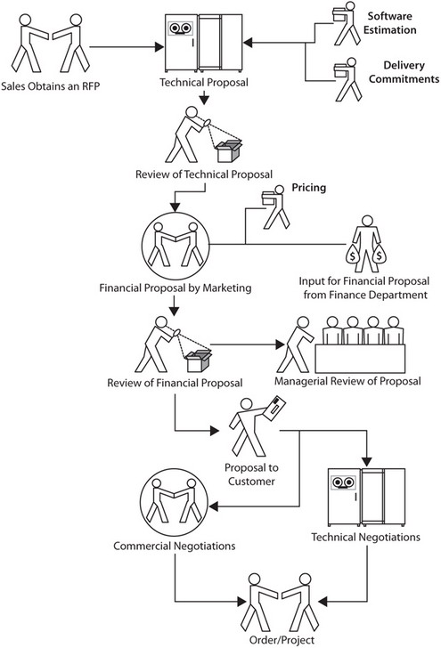

Slide 24
The Proposal
Software estimation
Delivery commitments
Pricing the proposal
Preparing the proposal

Slide 25
Software Estimation
Size of the software product to be produced.
Effort in person hours or person days.
Cost that will need to be expended.
Duration (schedule) in calendar days or months.

Slide 26
Delivery Commitments
The prospective client’s requirements/urgency
The competition (which might offer shorter delivery commitments)
The possibility of a future project that will require the release of resources from this project
Any other specific reason

Slide 27
Pricing Proposal
Commercial considerations.
The perceived necessity/desirability of acquiring the project.
The opportunity at hand.
Pricing models.

Slide 28
Pricing strategy
Order book position
Necessity to obtain an order
Desirability of winning the order
Stiff competition in the field
Monopolistic
Oligopolistic
Repeat orders
New market opportunity

Slide 29
project pricing typically follows a stepwise process
The technical team prepares the software estimates (software size, software development effort, and software development schedule) and presents them to the business acquisition team.
The business acquisition team prepares the cost estimation and presents it to the finance team.
The finance team suggests a floor price to the marketing team, below which the project will not be attractive financially.
The business acquisition team coordinates pricing with senior management (in some cases there might be a pricing committee) and determines:
The price to be offered to the potential client
The negotiation margin (if negotiations are foreseen)

Slide 30
Preparing the proposal
A proposal is usually a multipage document that has two separate parts
the technical proposal
the financial proposal.

Slide 31
Technical Proposal
Title page(containing the name of the project)
Contents (List the contents )
Introduction
Scope of work
Approach and methodology
Deliverables
Approvals required from the client
Schedule for project execution
Software estimation
Inclusions ( SE activities done)
Exclusions (SE activities not to be done)
Responsibilities

Slide 32
Financial Proposal
Fee (State the fee for the project)
Fee exclusions (Travels, Pilot run)
Validity period
Payment terms
Intellectual property rights (IPR)
Force majeure clause (war, floods, earthquakes, etc.)
Software tools or components to be supplied by the client
Facilities
Price escalation clause( Costs may increase)
Arbitration and jurisdiction (dispute resolution mechanisms )
Consequential liability (special damages)
Other

Slide 33
Negotiation
Public bidding: a prospective client posts an RFP on the Internet or in the press and invites bids from all organizations that meet the criteria contained in the RFP.
Private biding: In a private bidding scenario, two options are possible:
An RFP is raised on multiple prequalified vendors.
An RFP is raised on only one prequalified vendor. (This scenario occurs when an established relationship exists between a client and a vendor.)
Synthesis biding: The scenario is ad hoc in nature. Synthesis bidding is similar to a private bidding, but to obtain the best technical solution at the lowest possible price, new vendors are brought in to put pressure on existing vendors

Slide 34
Contract Acceptance
Price, delivery date, and payment terms are in agreement with those specified in the order.
All terms and conditions agreed upon and those specified in the order are in agreement.
Any new conditions are inserted in the order.
The scope of work is as agreed.

